Slide 1

ECOSYSTEM
BY – SHIVANSH CHAUHAN<2203892>
SHIVANSH PATIAL <2203893>

Slide 2
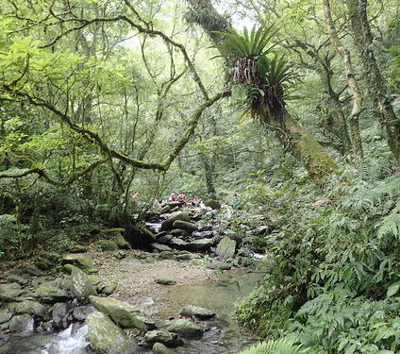
ECOSYSTEM
The term ecosystem was first coined by A.G. Tansely
Ecosystem consist of two words :
Eco -> Environment
System -> Interaction

Slide 3
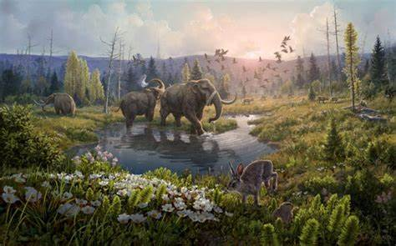
Ecosystem An ecosystem is the community of living organisms interacting with each other and their non living environment

Slide 4
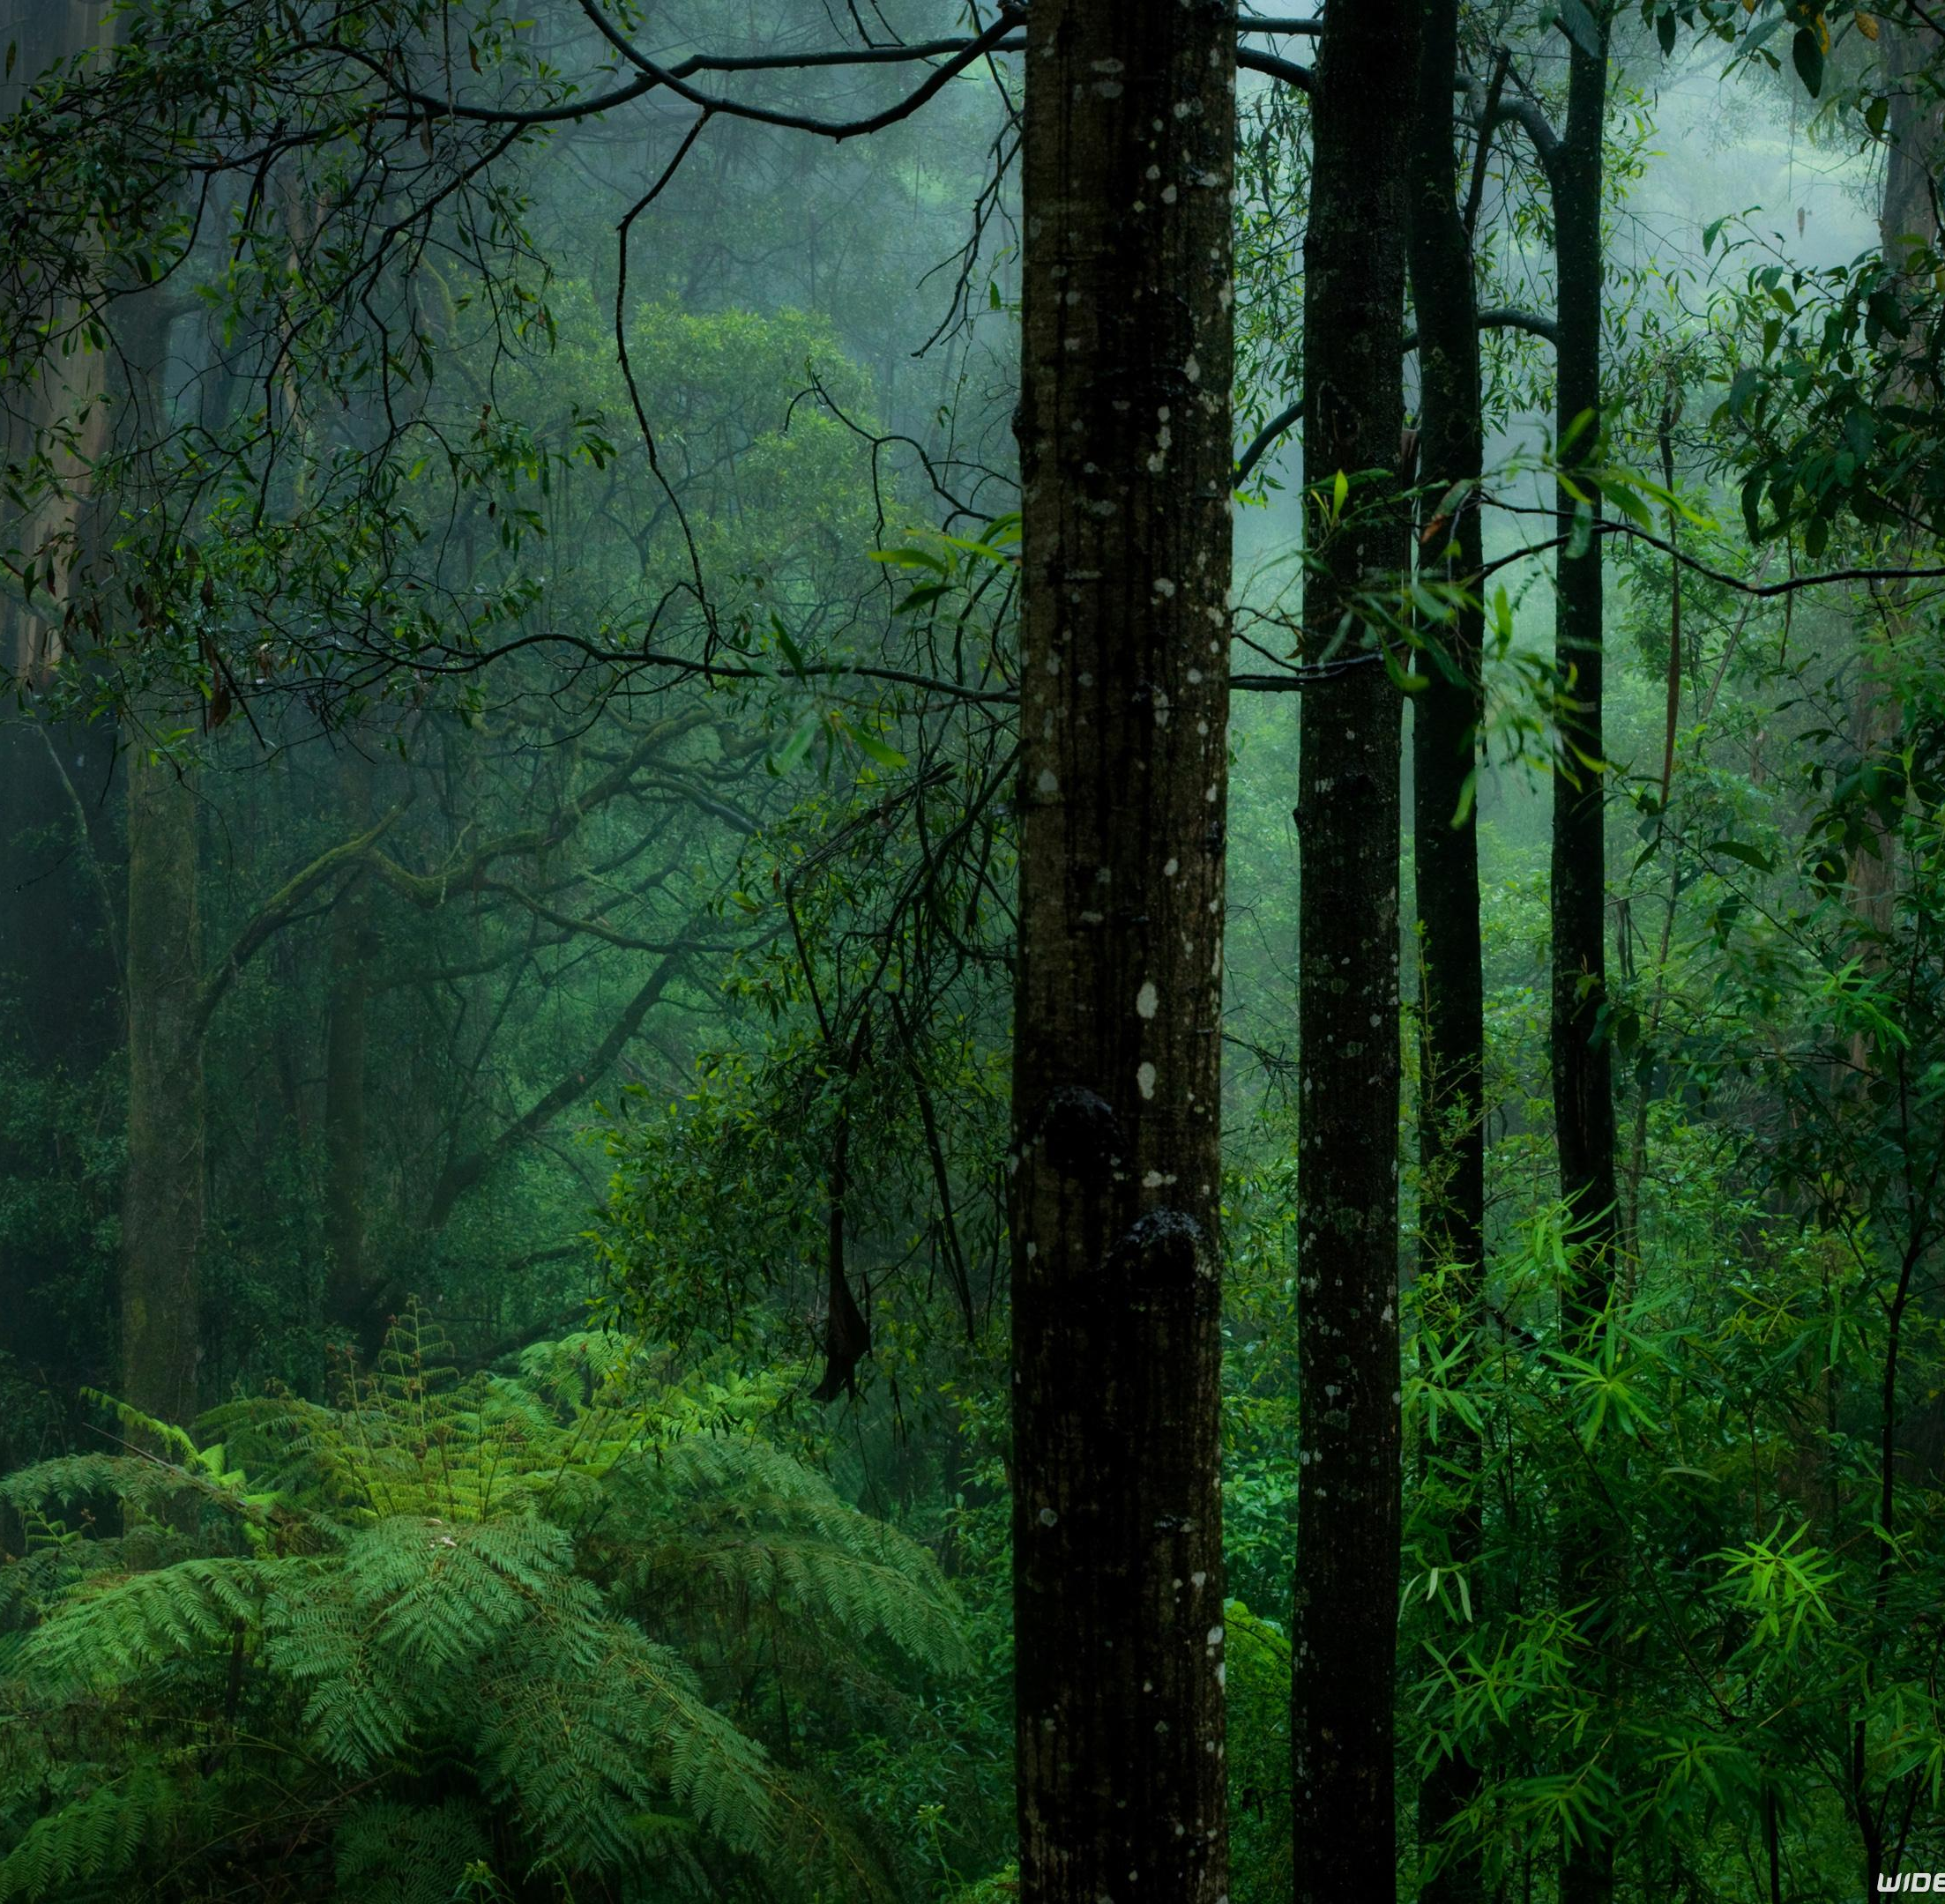

Examples Grassland, Forest,Aquarium,pond ,Lake,RIVER AND OCEAN

Slide 5
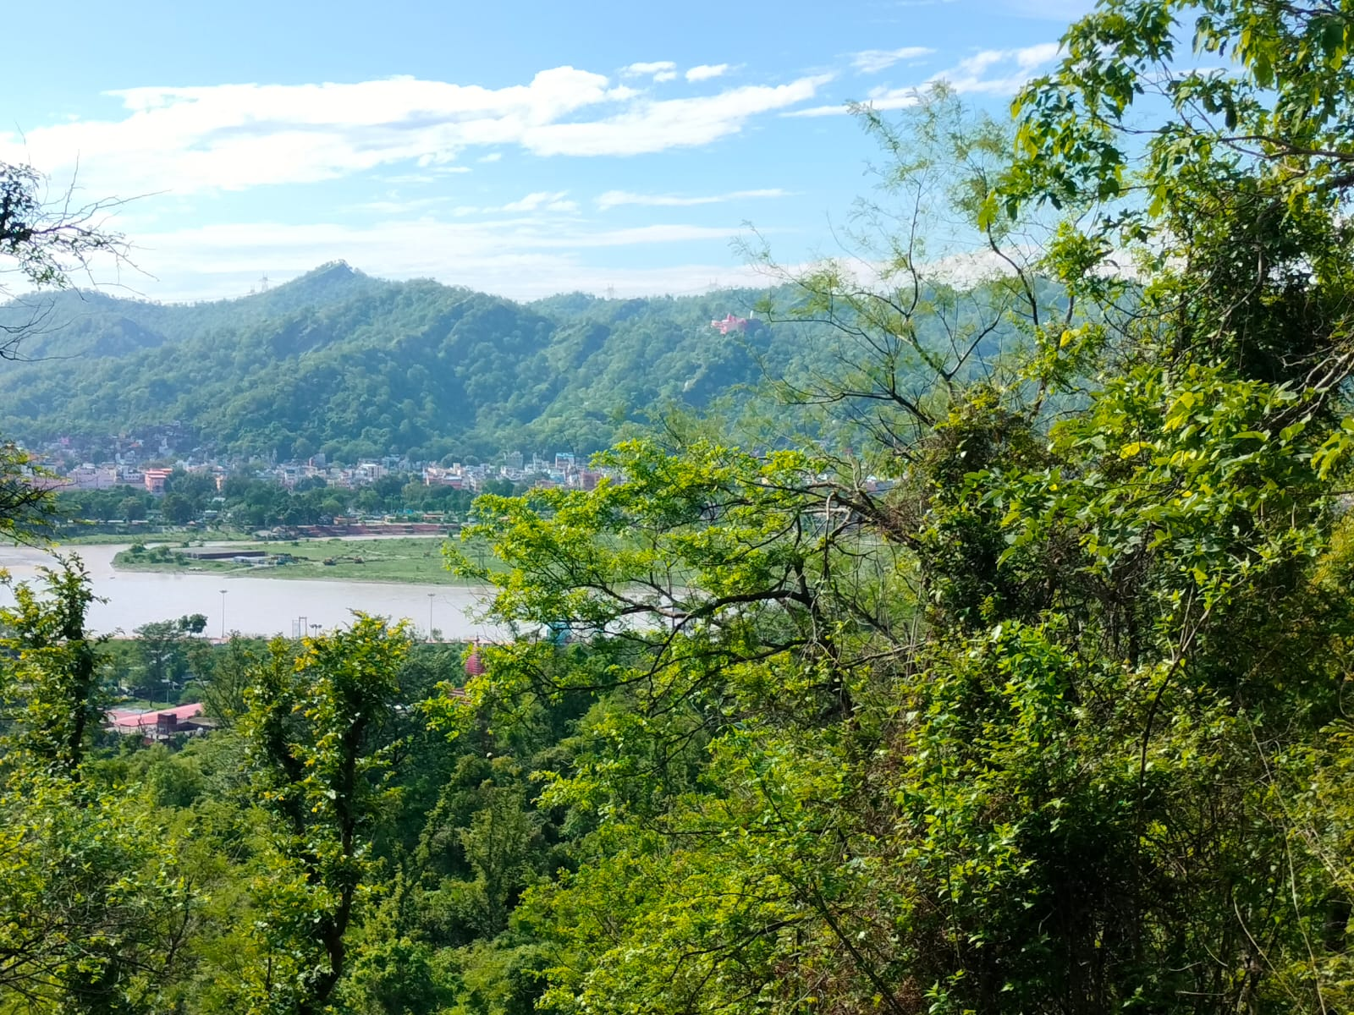
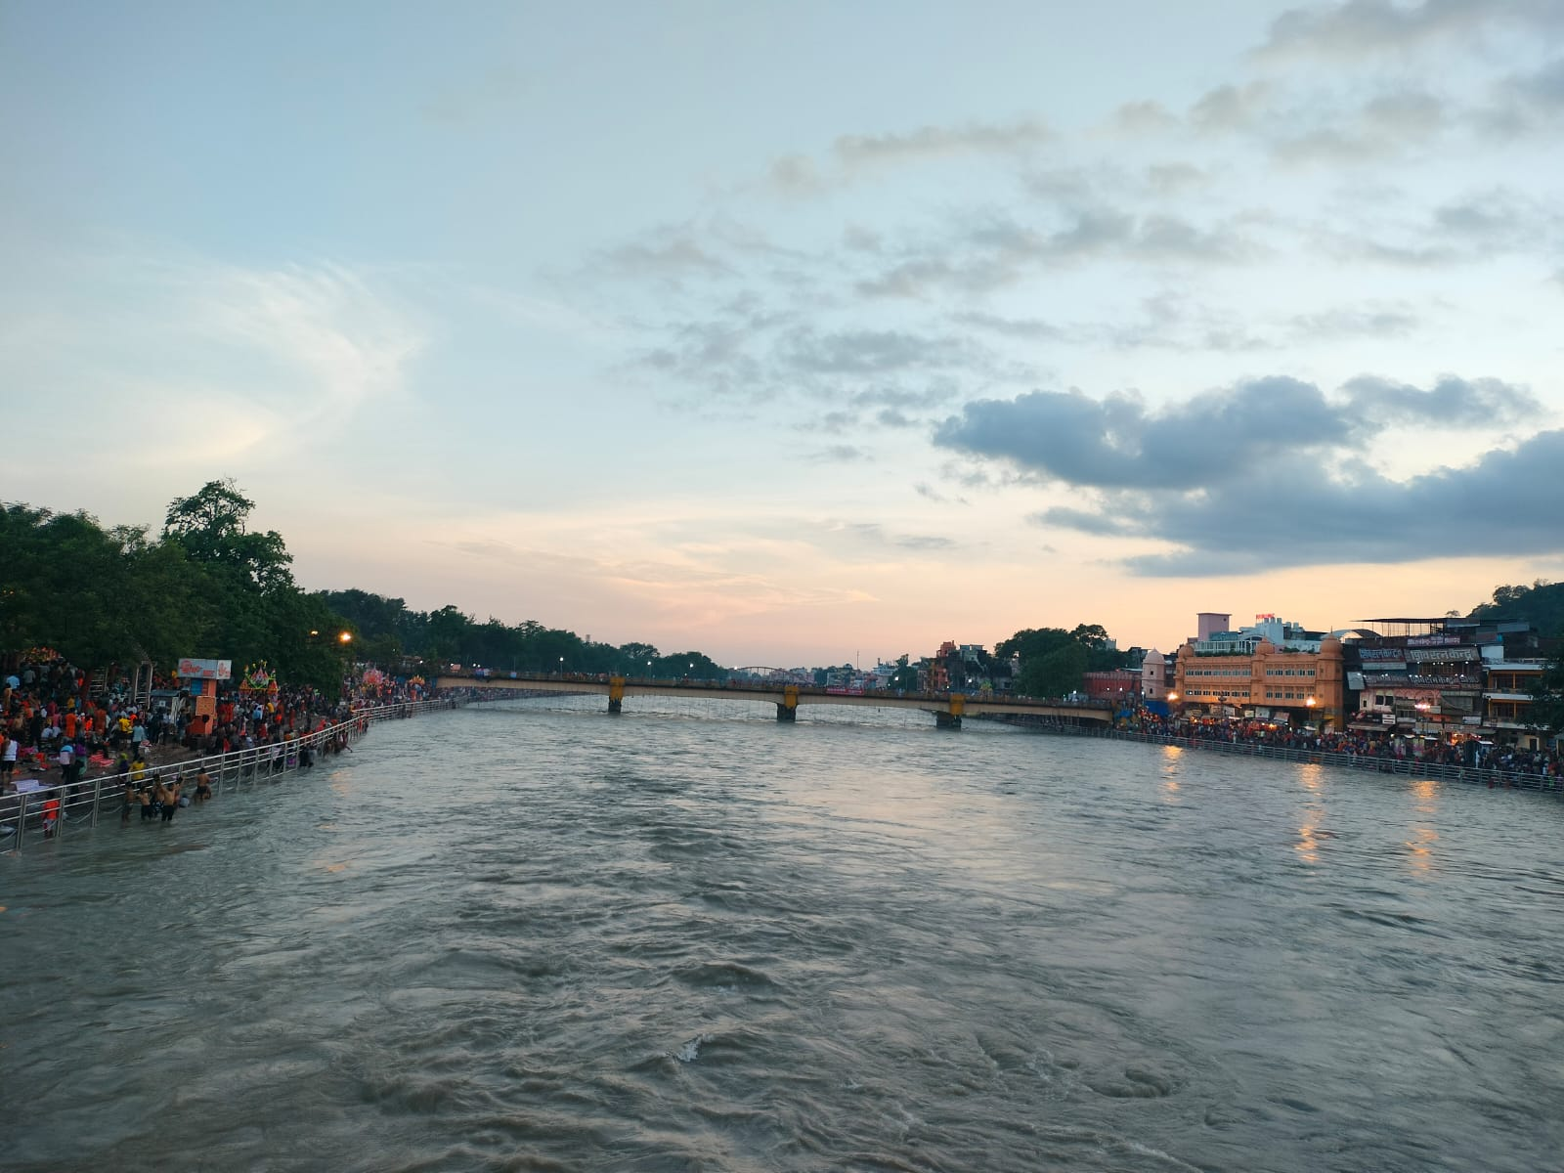
Types of Ecosystem
Terrestrial ex.Forest,grassland and desert
Aquatic ex.Pond,Lake,river and Estuary

Slide 6
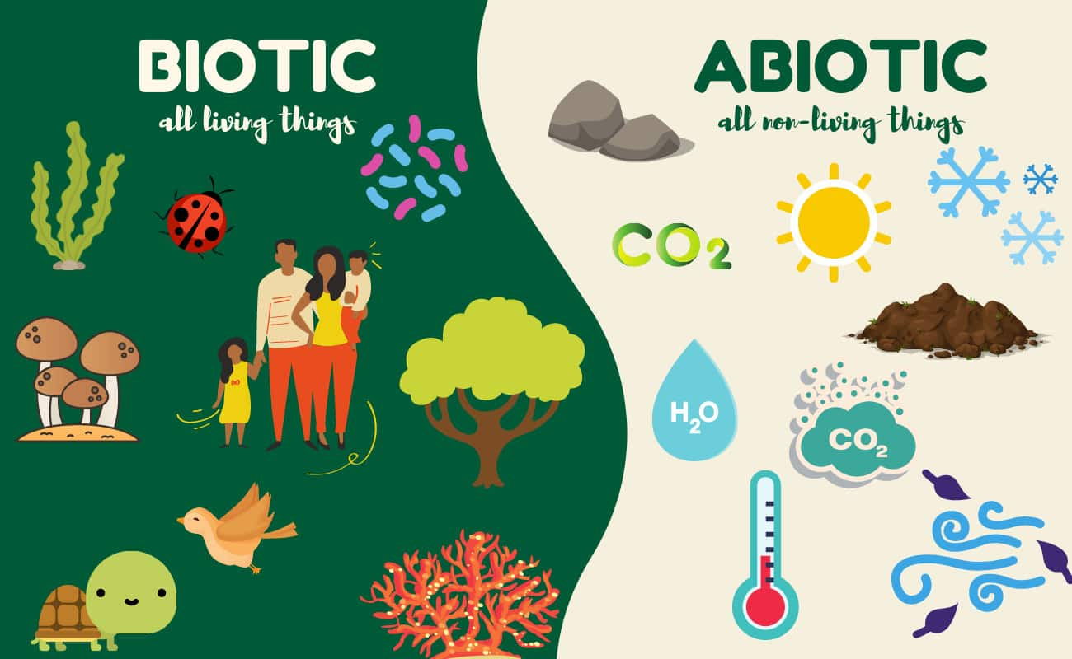
Structure of Ecosystem

Slide 7
Function of Ecosystem
Energy Flow
Foodchain
Foodweb
Decomposition
And many more....

Slide 8

ENERGY FLOW
The flow of energy is one way direction from producer to consumer and ends in decomposition process
However, a part of the energy is lost as heat and agrees with the phenomena of second law of THERMODYNAMICS

Slide 9
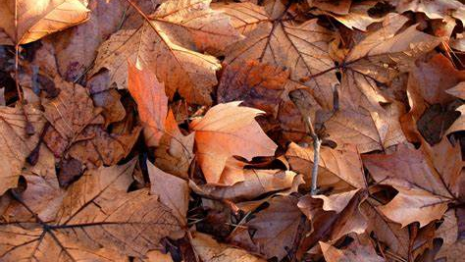
DECOMPOSITION The breakdown of complex organic matter into inorganic substances like carbon dioxide, water and nutrients and the process is called decomposition

Slide 10
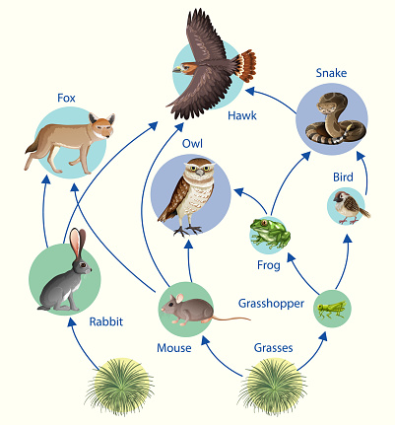
GRAZING FOOD CHAIN
The grazing food chain is a type of food chain in which energy at the lowest trophic level is acquired via photosynthesis. The grazing food chain begins with producers like green plants, who create their own food through the process of photosynthesis and later move from herbivores to carnivores. In the grazing food chain, energy is acquired from the sun.

Slide 11
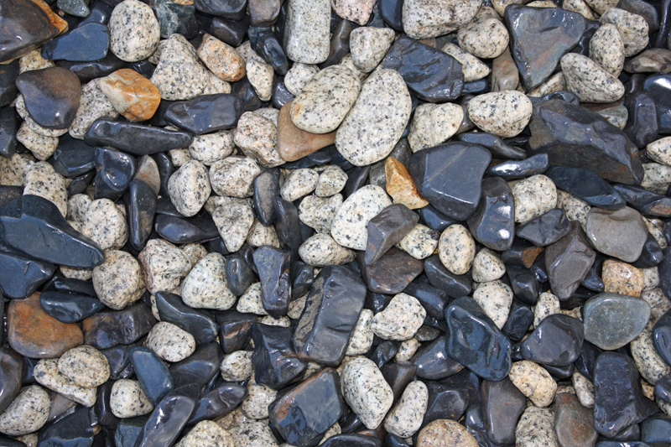
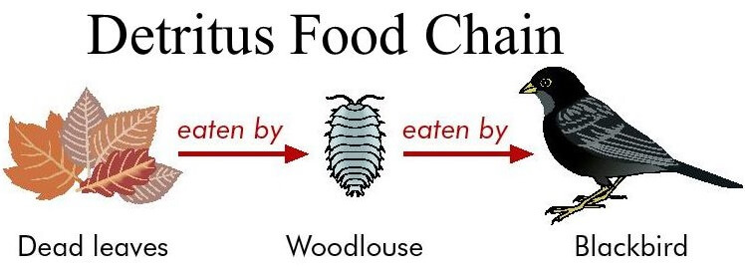
Detritus Food Chain
The detritus food chain is the one that starts with dead decomposing organic matter.
Algae, bacteria, fungus, protozoa, mites, insects, worms, and other creatures and plants are all part of the detritus food chain.

Slide 12
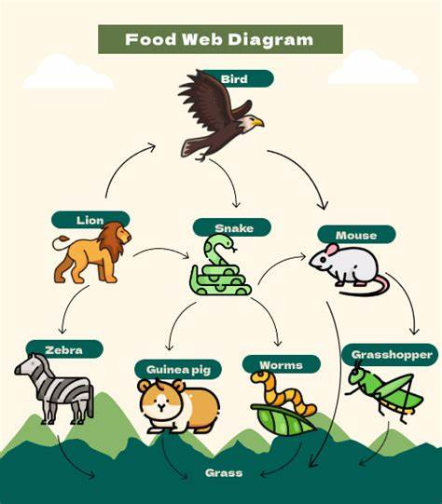
FOOD WEB
A food web is a detailed description of the species within a community and their relationships with each other; it shows how energy is transferred up food chains that are interlinked with other food chains.

Slide 13
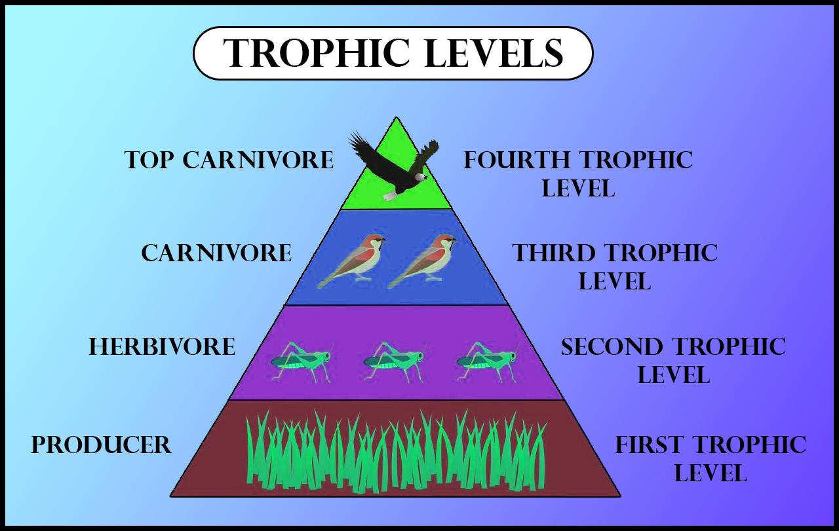
TROPHIC LEVEL
The trophic level of an organism is the position it occupies in a food web.

Slide 14
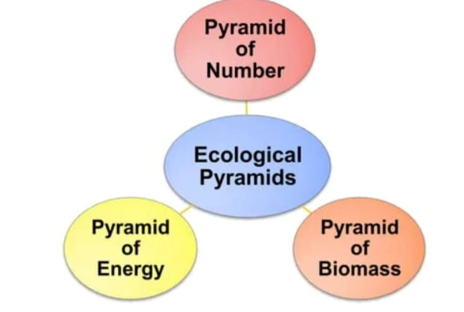
ECOLOGICAL PYRAMIDS
An ecological pyramid is a graphical representation of trophic levels in a given ecosystem

Slide 15
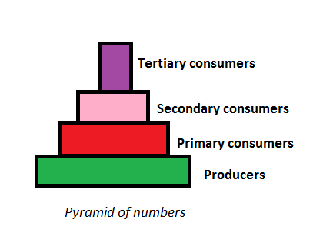
PYRAMID OF NUMBERS
It is a type of ecological pyramid
It depict the population or abundance of an individual species involved at each Level of a FOOD CHAIN

Slide 16
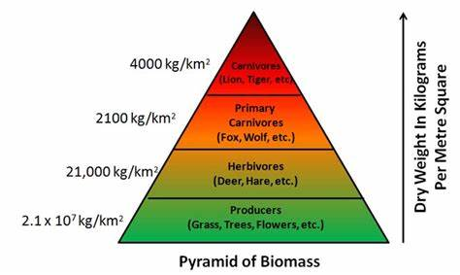
PYRAMID OF BIOMASS
A pyramid of biomass is a graphical representation of biomass present in a unit area of various trophic levels.

Slide 17
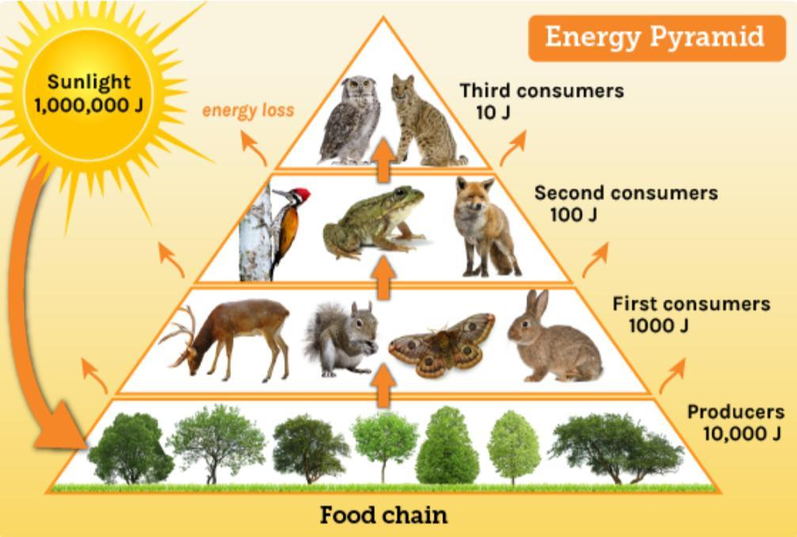
PYRAMID OF ENERGY
It shows how energy decrease as you move up the FOOD CHAIN

Slide 18
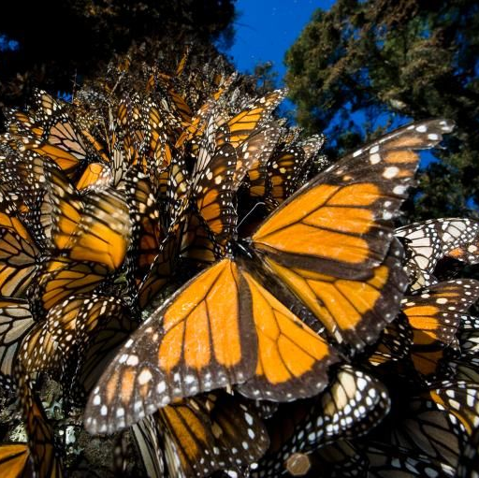
CASE STUDY "THE COME BACK OF THE MONARCH BUTTERFY"
The monarch butterfly, known for its striking orange and black wings, faced tough times due to habitat loss and pesticide use.

Slide 19
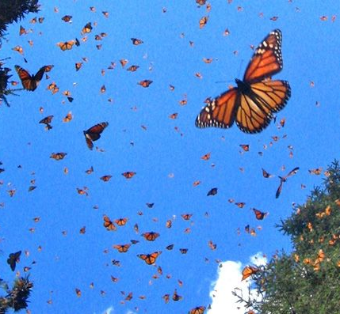
HISTORY
Monarch butterflies are famous for their incredible migrations from Canada to Mexico and back. However, their numbers started declining in the late 20th century.
This short case study shows how people helped this iconic butterfly make a comeback.

Slide 20
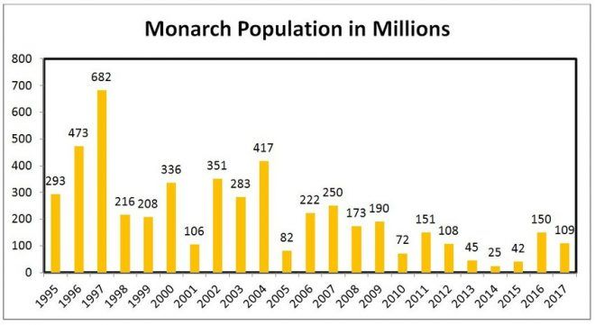
DECLINE
1. Habitat Loss: Logging and agriculture took away the forests and milkweed plants monarchs needed for breeding.
2. Pesticides: Pesticides, especially those affecting milkweed, harmed both adult butterflies and their caterpillars.

Slide 21
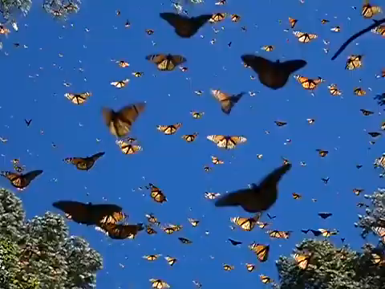
RECOVERY EFFORTS
People from different countries came together to help the monarchs:
1. Planting Milkweed: Many individuals and organizations started planting milkweed to provide essential food for monarch caterpillars.
2. Butterfly Sanctuaries: Mexico and the U.S. established protected areas where monarchs could winter without disturbance.
3. Education: Schools and groups taught people about monarchs and how to protect them

Slide 22


